Slide 1
GAME DESIGN PROPOSAL
RAVEN MORTIMER
&
BUU NGUYEN

Slide 2
IDEA 01

Slide 3
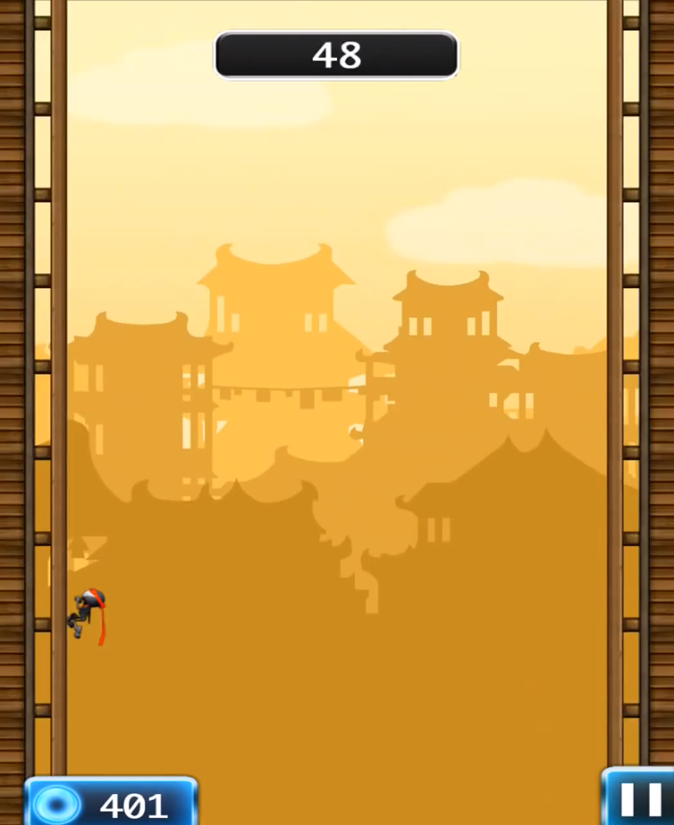
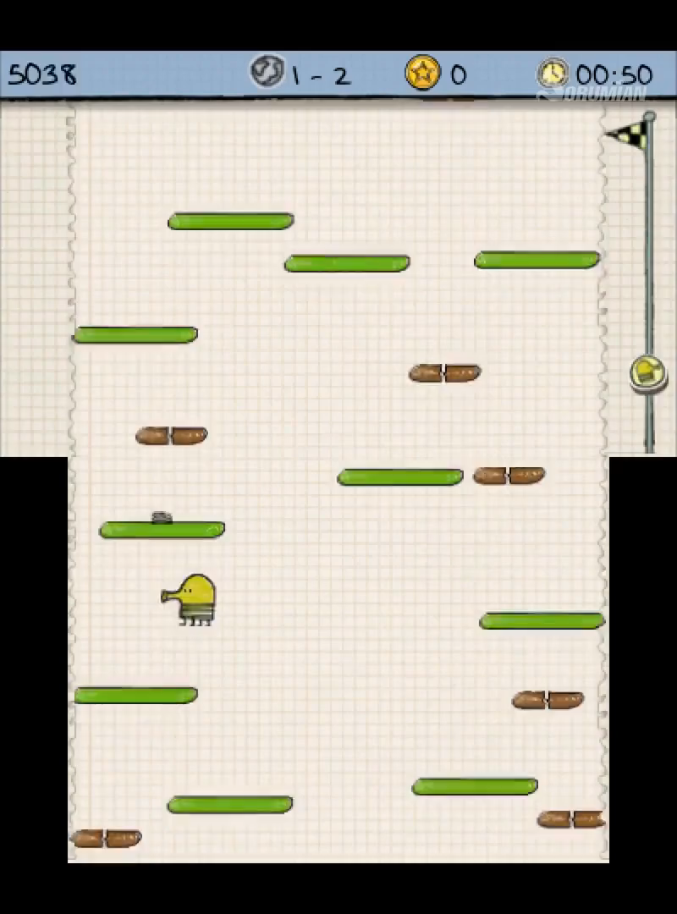
2D ENDLESS JUMPER

Slide 4
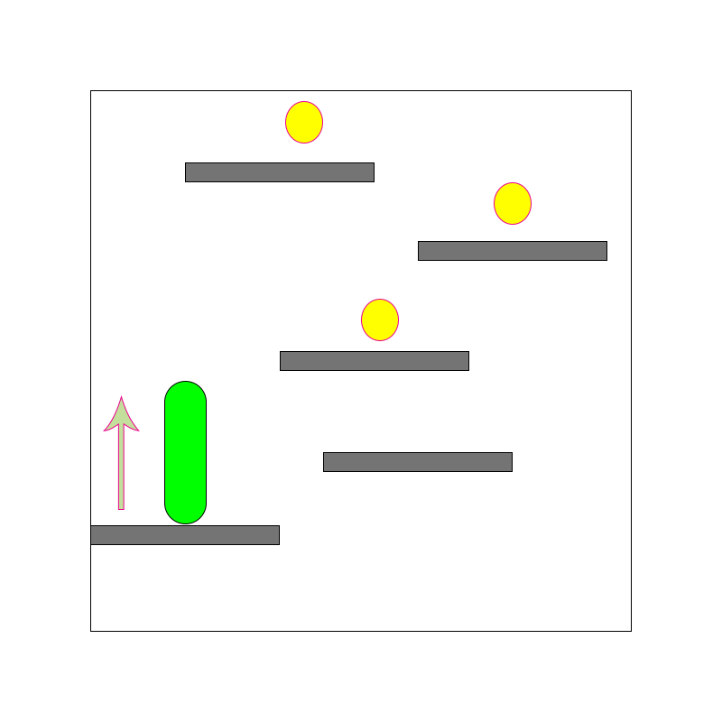
iJump
Endless jump
Power-up pick up
Money pick up
Booster Shop
High Score Record

Slide 5
CHALLENGES
Not yet decided theme and setting.
Randomize Tile/Platform Generator scaling with increasing Score at run time.
Difficulty balancing.
[from Artist perspective]
[from Artist perspective]
[from Artist perspective]

Slide 6
Beat chart
GAME ELEMENT
 |  | Early Game | Mid Game | Late Game
Gameplay Assets | Environment | Background 1, normal static tile, normal moving tile, 3-touch-break tile | Background 2, height boost tile, | Background 3, fake tile
 | Power-up |  | Jetpack | Screen-filled Tile
 | Money | Gold | Mega Gold (worth 10 Gold) | Live
Progression |  | No harmful tile | A few harmful tiles | Less normal tiles
Features |  | Buy back when dead (using Gold), Start at checkpoint (higher than normal), Player skins purchasing
SFX |  | Jump, Dead, Item Picked, Tile Break, Jetpack
Music |  | Fun, fast pace
Screens Assets | Main Menu | Background, UI
 | Shop | Background, UI

